Slide 1

Carr, Glenn, Little, Morrison, Tally, Upchurch
morr design ©

Slide 2
Carr, Glenn, Little, Morrison, Tally, Upchurch
Pro Dealer – The Whole Solution
Developer Introductions
Carr, Glenn, Little, Morrison, Tally, Upchurch
morr design ©

Slide 3
Carr, Glenn, Little, Morrison, Tally, Upchurch
Justin – ER Diagrams
Talmage – Tables, SQL, Java, Crow’s Foot
Darius – Tables, Phase 3 SQL, Crow’s Foot
Nate – Project Management, Visual Studio, Tables
Miles – Tables
Michael – Tables
morr design ©

Slide 4
Carr, Glenn, Little, Morrison, Tally, Upchurch
Dealership Management Software
Tracks – Customers, Employees, Vehicles, Vendors, Locations, Service Centers & Finances
Allows for Deal-Specific Identification
Employs Industry-Standard Tracking
Offers Four Job Specific User Interfaces
  • Finance, Sales, Service, Management
  • User is Automatically Taken to Proper Interface at Login
morr design ©

Slide 5
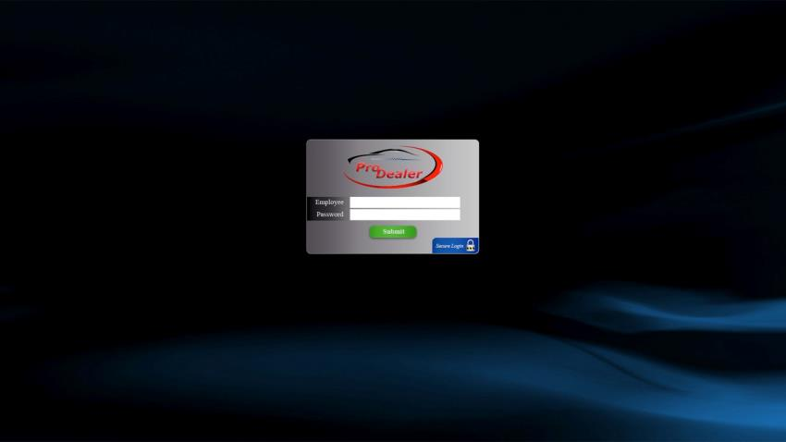
Carr, Glenn, Little, Morrison, Tally, Upchurch
Conceptual Login Window
morr design ©

Slide 6
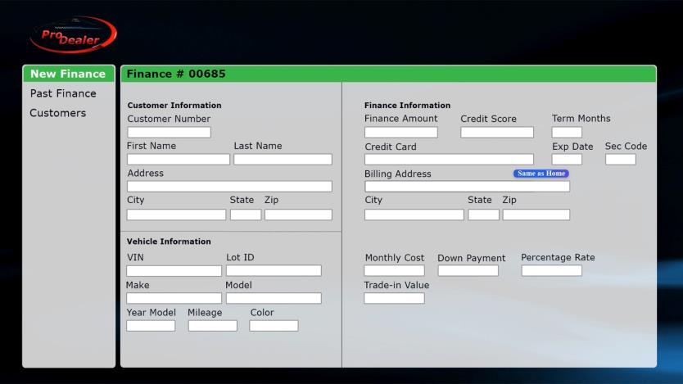
Carr, Glenn, Little, Morrison, Tally, Upchurch
Conceptual Finance User Interface
morr design ©

Slide 7
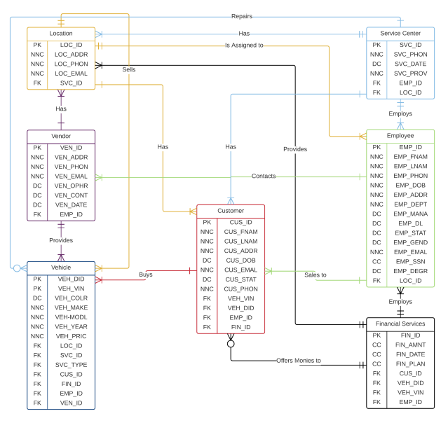
Carr, Glenn, Little, Morrison, Tally, Upchurch
ERD &
Workflow
morr design ©

Slide 8
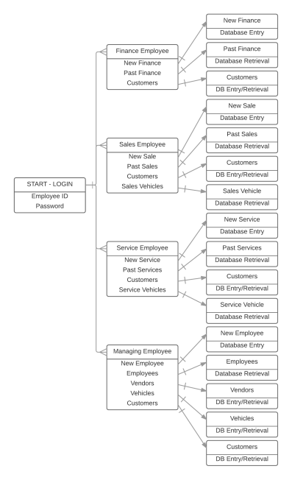
Carr, Glenn, Little, Morrison, Tally, Upchurch
User Interface
Workflow
morr design ©

Slide 9
Carr, Glenn, Little, Morrison, Tally, Upchurch
Live Demo
Nate Morrison
Carr, Glenn, Little, Morrison, Tally, Upchurch
morr design ©

Slide 10
Carr, Glenn, Little, Morrison, Tally, Upchurch
Questions?
morr design ©

